Slide 1
SPARK
Architecture, RDD’s

Slide 2
What is Spark ?
Apache Spark is a lightning-fast cluster computing technology, designed for fast computation.
Spark is not a modified version of Hadoop
It is based on Hadoop MapReduce and it extends the MapReduce model to efficiently use it for more types of computations, which includes interactive queries and stream processing.
The main feature of Spark is its in-memory cluster computing that increases the processing speed of an application.
Covers wide range of workloads – Streaming – No need of other separate tools.

Slide 3
Why Spark ? - Its all about speed !
The reason is that Hadoop framework is based on a simple programming model (MapReduce)
Here, the main concern is to maintain speed in processing large datasets in terms of waiting time between queries and waiting time to run the program.
Speed − Spark helps to run an application in Hadoop cluster, up to 100 times faster in memory, and 10 times faster when running on disk. This is possible by reducing number of read/write operations to disk. It stores the intermediate processing data in memory.
Supports multiple languages − Spark provides built-in APIs in Java, Scala, or Python. Therefore, you can write applications in different languages.
Advanced Analytics − It supports SQL queries, Streaming data, Machine learning (ML), and Graph algorithms.

Slide 4
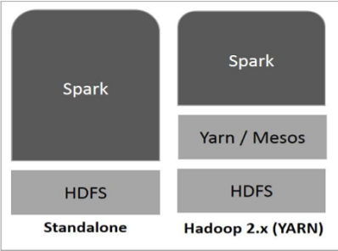
Implementation ? – Not a problem

Slide 5
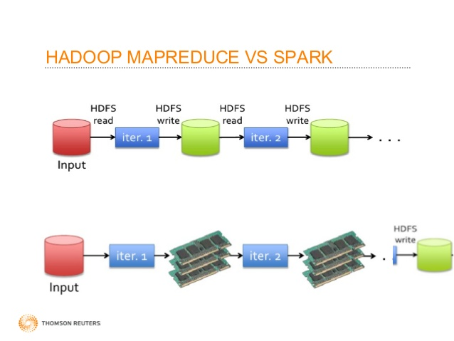
Seeing is believing right ? Here is how they work

Slide 6
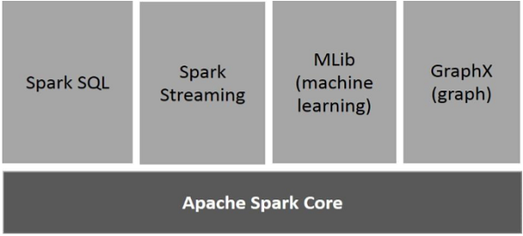
Spark Components

Slide 7
Spark Components
Spark Core is the underlying general execution engine for spark platform that all other functionality is built upon. It provides In-Memory computing and referencing datasets in external storage systems.
Spark SQL is a component on top of Spark Core that introduces a new data abstraction called SchemaRDD, which provides support for structured and semi-structured data.
Spark Streaming leverages Spark Core's fast scheduling capability to perform streaming analytics. It ingests data in mini-batches and performs RDD (Resilient Distributed Datasets) transformations on those mini-batches of data
MLlib is a distributed machine learning framework above Spark because of the distributed memory-based Spark architecture.
GraphX is a distributed graph-processing framework on top of Spark. It provides an API for expressing graph computation

Slide 8
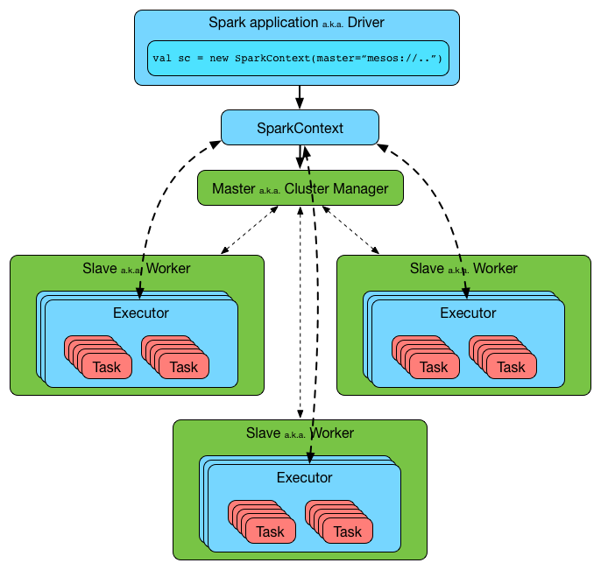
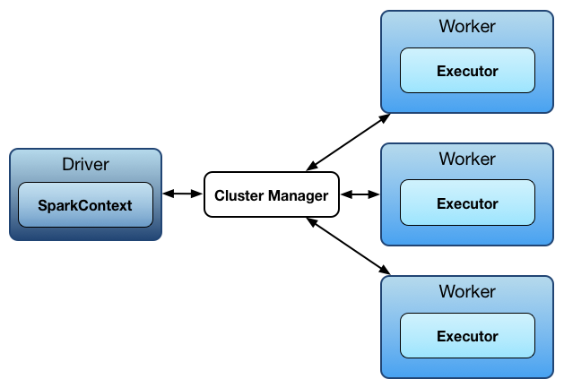
Spark and its Architecture

Slide 9
Spark Architecture – Driver
Spark uses a master/worker architecture. There is a driver that talks to a single coordinator called master that manages workers in which executors run.
A Spark driver (aka an application’s driver process) is a JVM process that hosts SparkContext for a Spark application. It is the master node in a Spark application.
It splits a Spark application into tasks and schedules them to run on executors.
A driver is where the task scheduler lives and spawns tasks across workers.
A driver coordinates workers and overall execution of tasks

Slide 10
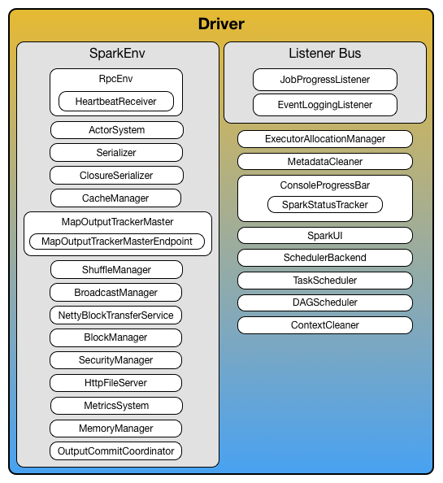
Spark Architecture – Driver

Slide 11
Spark Architecture - Executor
Executor is a distributed agent that is responsible for executing tasks.
Executor typically runs for the entire lifetime of a Spark application which is called static allocation of executors (but you could also opt in for dynamic allocation).
Executors report heartbeat and partial metrics for active tasks to “heart beat receiver” RPC endpoint on the driver
Executors provide in-memory storage for RDDs that are cached in Spark applications
Executors are described by their id, hostname, Environment and classpath

Slide 12
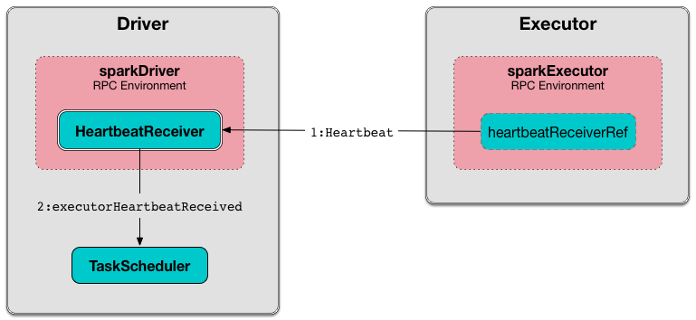
Spark Architecture - Executors

Slide 13
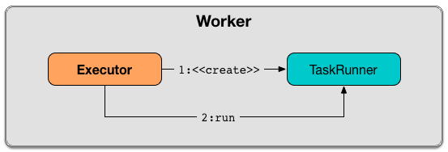
Spark Architecture – Task Runner
Task Runner is a thread of execution that manages a single individual task.
It is created exclusively when executor is requested to launch a task

Slide 14
Spark Architecture – Worker
Workers (aka slaves) are running Spark instances where executors live to execute tasks. They are the compute nodes in Spark.
It hosts a local Block Manager that serves blocks to other workers in a Spark cluster. Workers communicate among themselves using their Block Manager instances.

Slide 15
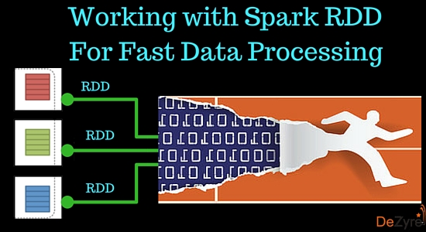
RDD’s
Resilient Distributed Datasets (RDD) is a fundamental data structure of Spark.
It is an immutable distributed collection of objects. Each dataset in RDD is divided into logical partitions and can store in-memory on worker nodes.
Resilient - Meaning it provides fault tolerance through lineage graph. A lineage graph keeps a track of transformations to be executed after an action has been called. RDD lineage graph helps recomputed any missing or damaged partitions because of node failures.
Distributed - RDDs are distributed - meaning the data is present on multiple nodes in a cluster.

Slide 16
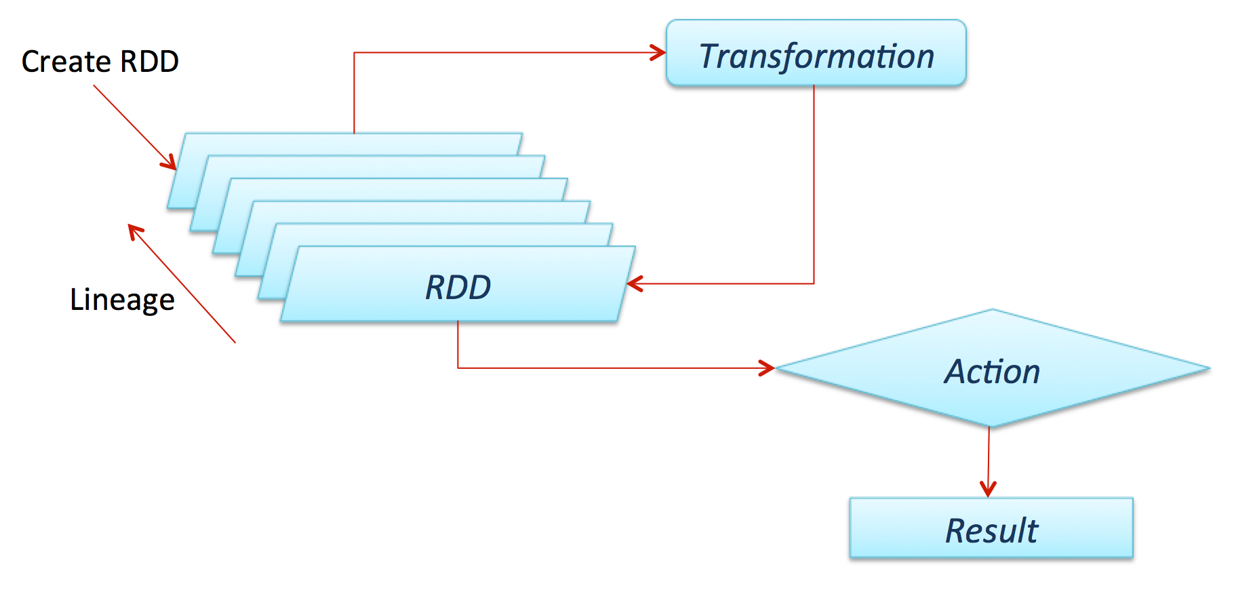
RDD

Slide 17
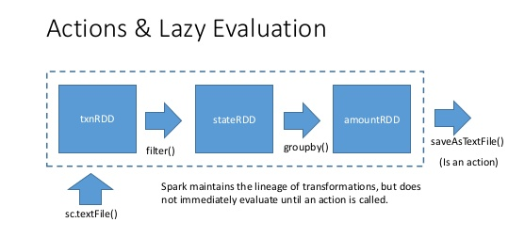
RDD’s – features
Immutable - They read only abstraction and cannot be changed once created. However, one RDD can be transformed into another RDD using transformations like map, filter, join, cogroup, etc. Immutable nature of RDD Spark helps attain consistencies in computations.
Partitioned - RDDs in Spark have collection of records that contain partitions. Partitions in RDDs are the basic units of parallelism.
Lazy Evaluated - RDDs are computed in a lazy manner, so that the transformations can be pipelined. Data inside RDDs will not be transformed unless, an action that triggers the execution of transformations is invoked

Slide 18
RDD’s – features
Persistence - The persistence of RDDs makes them good for fast computations. Users can specify which RDD they want to reuse and select the desired storage for them -whether they would like to store them on disk or in-memory.
Fault Tolerance - Spark RDDs log all transformation in a lineage graph so that whenever a partition is lost, lineage graph can be used to reply the transformation instead of having to replicate data across multiple nodes (like in Hadoop MapReduce).

Slide 19
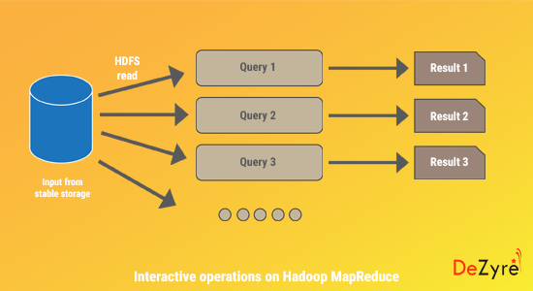
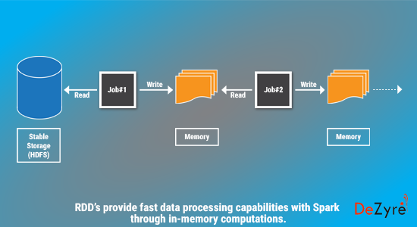
Interactive operations

Slide 20
DAG – Directed Acyclic Graph
Direct - Transformation is an action which transitions data partition state from A to B.
Acyclic -Transformation cannot return to the older partition
DAG is a sequence of computations performed on data where each node is an RDD partition.
The DAG scheduler divides operators into stages of tasks. A stage is comprised of tasks based on partitions of the input data. The DAG scheduler pipelines operators together.
The Stages are passed on to the Task Scheduler. The task scheduler launches tasks
The Worker executes the tasks on the Slave.

Slide 21
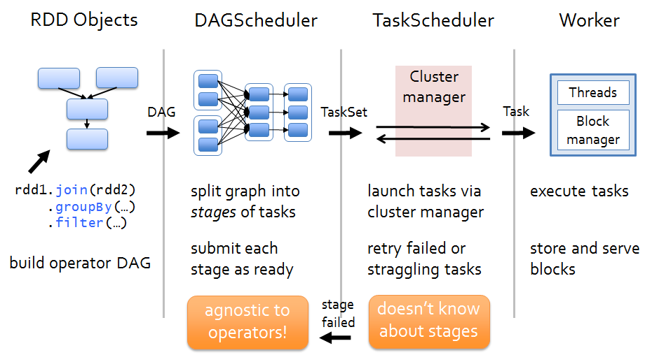
How a program executes ?

Slide 22
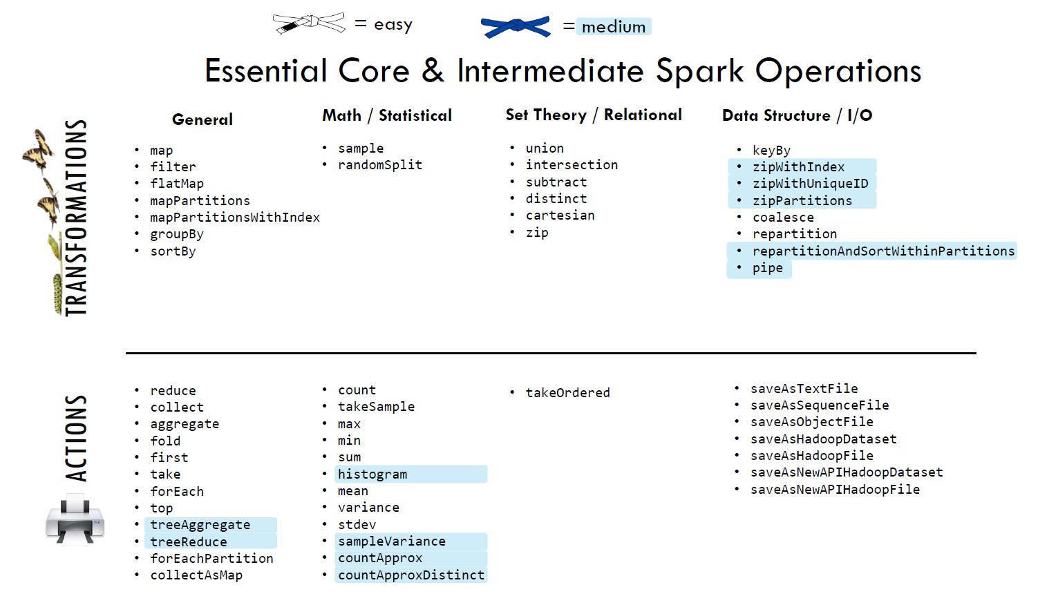

Slide 23
What is a Transformation?
RDD transformations returns pointer to new RDD and allows you to create dependencies between RDDs.
Each RDD in dependency chain (String of Dependencies) has a function for calculating its data and has a pointer (dependency) to its parent RDD.
Transformations are just manipulations of the data
Each time new RDD is created when we apply any transformation.
Applying transformation built an RDD lineage, It is a logical execution plan i.e., it is Directed Acyclic Graph (DAG) of the entire parent RDDs of RDD.

Slide 24
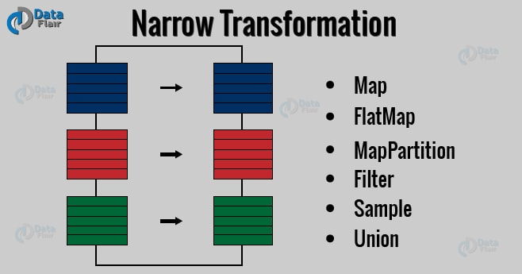
Two Types of Transformations
Narrow transformation – In Narrow transformation, all the elements that are required to compute the records in single partition live in the single partition of parent RDD. A limited subset of partition is used to calculate the result. Narrow transformations are the result of map(), filter().

Slide 25
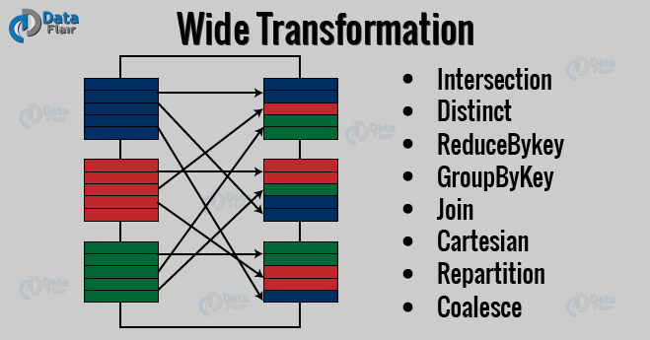
Two Types of Transformations
Wide transformation – In wide transformation, all the elements that are required to compute the records in the single partition may live in many partitions of parent RDD. The partition may live in many partitions of parent RDD. Wide transformations are the result of groupbyKey() and reducebyKey().

Slide 26
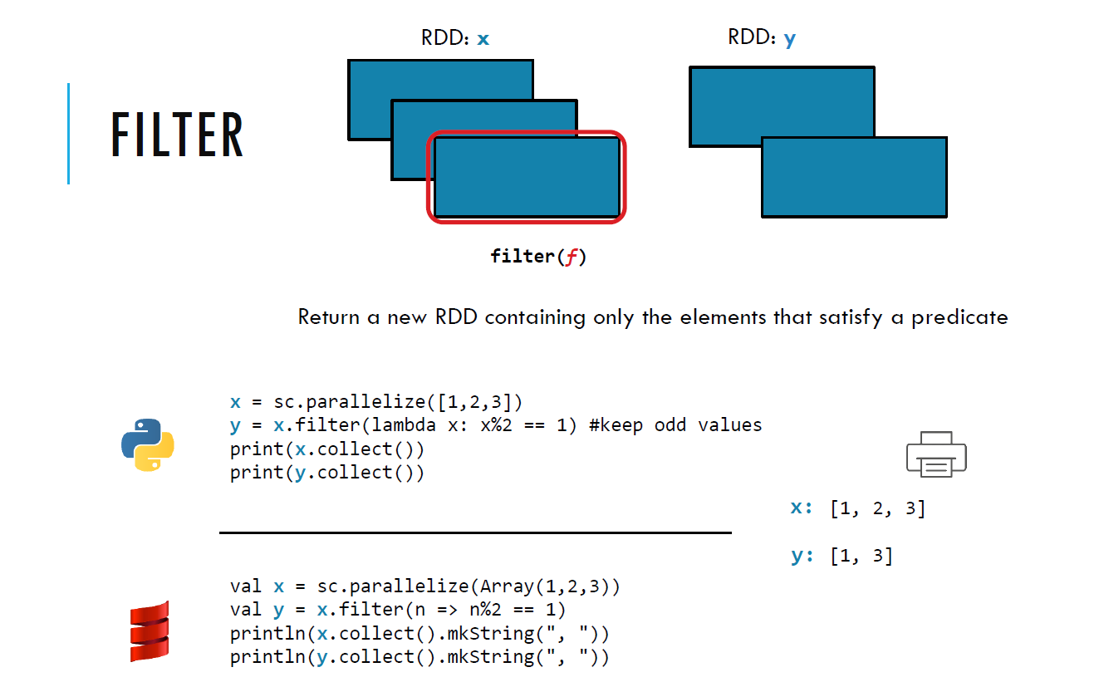
FILTER (Transformation)

Slide 27
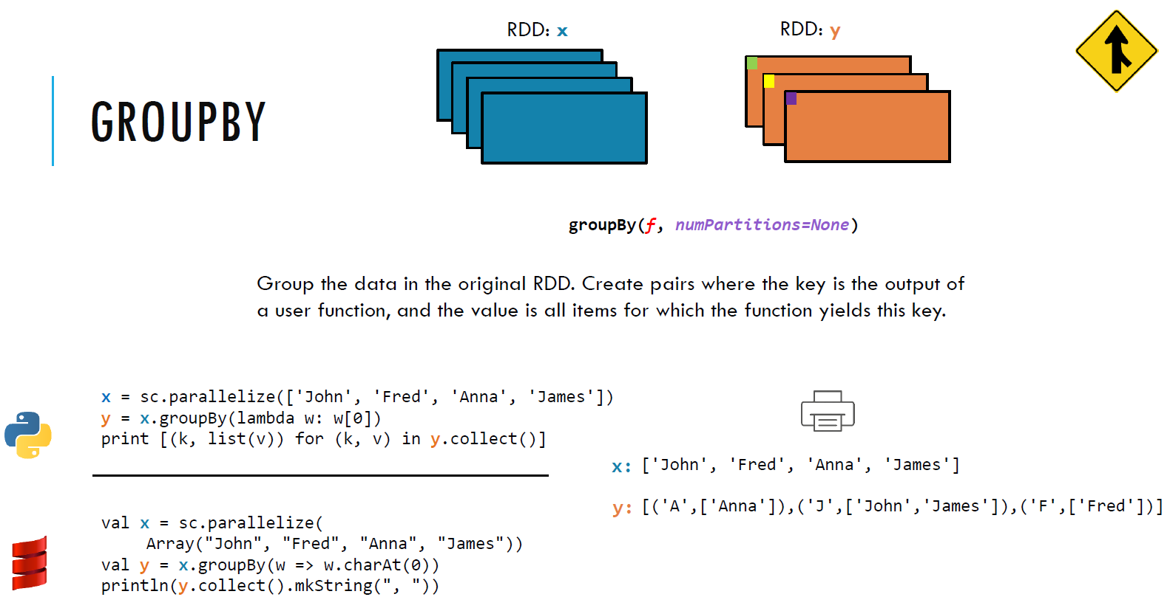
GROUPBY(Transformation)

Slide 28
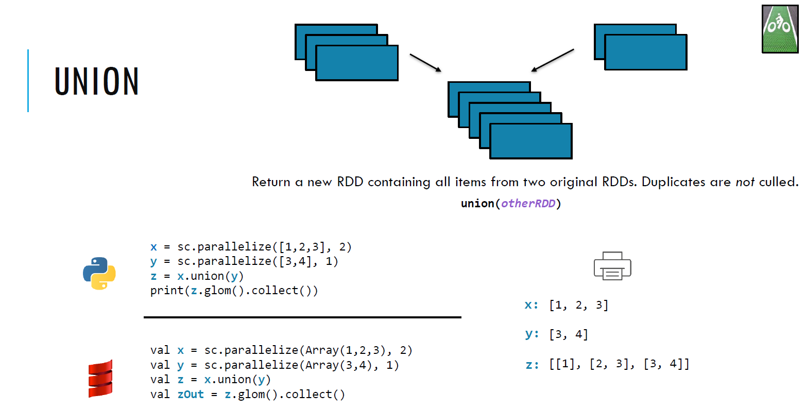
UNION(Transformation)

Slide 29
Actions
Actions are Spark RDD operations that give non-RDD values.
The values of action are stored to drivers or to the external storage system.
It brings laziness of RDD into motion.

Slide 30
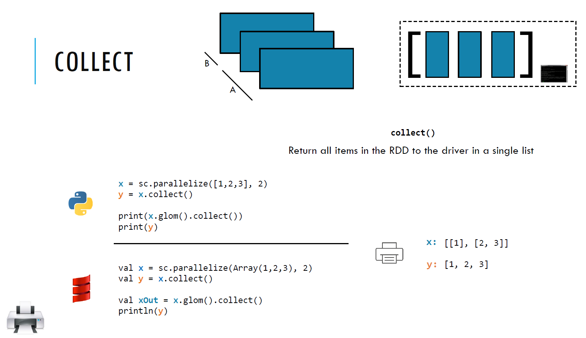
COLLECT(Action)

Slide 31
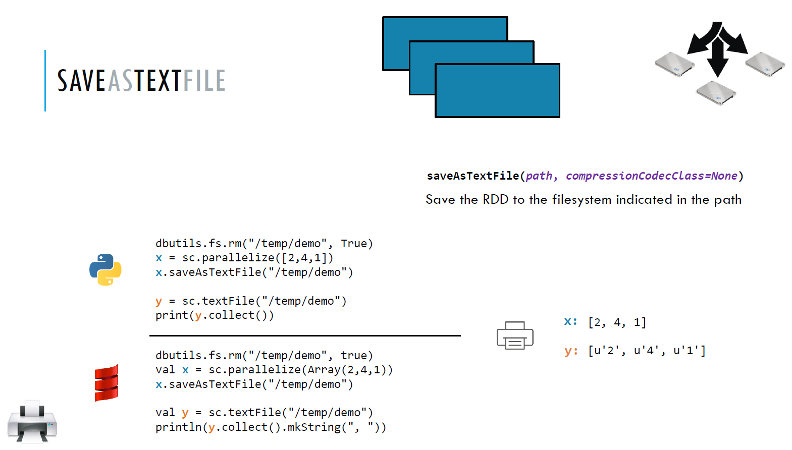
SaveAsTextfile(Action)

Slide 32
Two types of Shared variables
Accumulators : Aggregate information
Broadcast variables : distribute large values
Shared Variables

Slide 33
Accumulators
All functions (map,filter) use variables defined in driver program and gets a new copy of the variable in worker nodes
It not returns any value to the driver program
Variables created as accumulators , will return value to diver program
It is similar to counter concept in MR.
Its write-only variable

Slide 34
Accumulators
val file = sc.textFile(“file.txt”)
#creating an accumulator
val blanklines = sc.accumulator(0)
val count =file.flatMap(x => {
if(x=“”){ blankLines+=1}
line.split(“ ”)
}
}
count.collect.foreach(println)
Println(“Blank Lines : ”+blankLines.value)

Slide 35
Accumulators
Create accumulator is SparkContext.accumulator(initial values)
Worker code can update the value (+=)
Driver program can get the value , once action function is executed.
Even though RDD’s are recreated multiple time due to fault tolerance or speculative execution., it not impacts accumulator value.
You can write your own accumulators

Slide 36
Broadcast Variables
Allows the program to efficiently share the large , read-only value to all the worker nodes for use in one or more spark operations.
For example, country code lookup we can pass as a broadcast variable.
Look up file will be copied to the all worker nodes.
Similar to distributed cache concept in MR
It’s a read –only variable.
val bvalue= sc.broadcast(<values>:any collection)

Slide 37
Broadcast Variables
Create broadcast variable as SparkContext.broadcast( values)
Worker code can get using the value property
Variables shared to worker nodes only once and should be treated as read only
val broadcastVar = sc.broadcast(Array(1, 2, 3))
Conf.setInt(“col_pos”,2)
Setup

Slide 38


